Slide 1
Phylum Onychophora
P Vinod
PG Department of Zoology

Slide 2
Triploblastic, bilaterally symmetrical
Thin cuticle composed of α – chitin
Body has anterior head & posterior trunk
Tagmosis : grouping of body segments into similar regions, similar functions, and similar appendages
Head has 3 pairs of appendages
Body cavity has bood (open type)
Heart lies in pericardial sinus
Repiration through air filled tracheae
Excretion through paired nephridia
Nervous system has dorsal brain and ventral nerve cords
Sensilla and eyes are sensory
Body wall has many papillae
Sexes separate and sexually dimorphic
Viviparous
Considered as living fossil because the living members appear similar to fossil species as much as 570 million years old

Slide 3
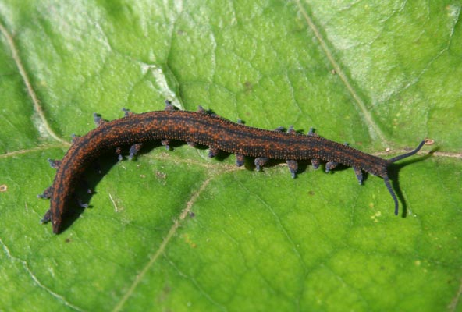
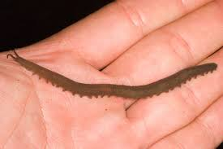

Slide 4
Peripatus (“claw bearers”)
Nocturnal, living in moist & shady regions in forests (2 – 8 cm long body)
Feeds on small insects
Body soft, elongated and vermiform – segmented
Head consists of 3 segments carrying 3 pairs of appendages, a pair of simple eyes & a mouth.
Anterior segment carries preantennae which bears many rings of tubercles
2nd segment bears 2 claw-like jaws (mandibles)
3rd segment are a pair of oral papillae
Trunk has many wrinkles or annuli
Each annulus bears numerous conical tubercles and they end in chitnous spines
Each trunk segment carries a pair of ventro-lateral walking legs which is outgrowth of body wall
Foot ends in a pair of claws
Coxal organs, anus, etc lies at ventral side
A tube heart present in pericardinal sinus and opens into pericardial cavity through ostia
Stigmata are openings of body surface through which tracheal tubes open for respiration
Nephridiopores at the bases of legs are openings of nephridia for excretion
A pair of oval ganglia in head and double ventral nerve cord comprises nervous system
Peripatus is gonochoric and development without any larva

Slide 5
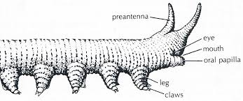
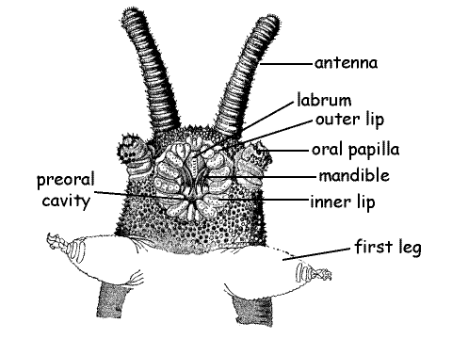

Slide 6
Comment on the phylogenetic status of Peripatus./Discuss on the systematic position of Peripatus.
Peripatus have both annelidan & arthropodan characteristics. Therefore they are regarded to be intermediate stage or connecting link between Annelida & Arthropoda.
However they appear to be more closely allied to arthropods than to annelids. They may represent an offshoot from near the base of the arthropod line. Based on such phylogenetic considerations, Manton & other contemporary zoologists have included onychophorans (Peripatus) within the Arthropoda as a subphylum or class.
But absence of exoskeleton, & jointed limbs & the presence of primary annelid characters in Onychophora create serious problems.
In fact, onychophorans are neither annelids nor arthropods but possess distinct characteristics of their own. Hence now a days, Onychophora is considered as a separate phylum.
The modern view holds that Onychophora is not an evolutionary link between Annelida & Arthropoda but a distinct surviving branch. This is supported by the discovery of a mid-Cambrian fossil, Aysheaia which closely resembles the modern Onychophora.

Slide 7
Arthropod characters of Onychophora
Presence of antennae.
Body is covered with chitinous cuticle.
Appendages are provided with claws.
Jaws are modified appendages, provided with striped muscles.
Locomotion by definite legs having definite musculature.
Presence of haemocoel.
Dorsal tubular heart with lateral ostia.
Presence of tracheal respiratory system.
Coelom reduced to small cavities that surround the excretory & reproductive ducts.
Peculiar salivary gland supposed to be modified nephridia.
Brain is large & typically arthropodan.
General structures of the reproductive organs & development mainly arthropodan.

Slide 8
Annelid characters of Onychophora
Vermiform body with truncated extremities.
Absence of true head.
Outer body covering is cuticle, skin thin & flexible.
Muscles separate in identical way.
locomotion slow & by peristalsis as in an earthworm.
Simple & straight alimentary canal.
Paired, segmentally arranged nephridia.
Presence of cilia in excretory & reproductive ducts.
Structure of eye same as in polychaetes.
Slime & coxal glands correspond with similar glands of chaetopods.

Slide 9
Onychophoran characteristics
Body shows no or indistinct segmentation.
Texture of skin. A rough cuticle covered with numerous velvety processes not known in other phyla.
Antennae not homologous to the antennae of other arthropods.
3 segmented head of Peripatus shows a condition mid way between that of Annelida & Arthropoda.
Restriction of jaws to a single pair. Movement of jaws is antero-posterior.
Presence of non jointed legs with claws.
Irregular distribution of spiracles or tracheal openings.
2 ventral nerve cords widely separated & without true ganglia.
Structure of eye less complicated.
Distribution of reproductive organs.

Slide 10
Make a note on the geographical distribution of Peripatus
The genus Peripatus is found restricted in various places of world such as South America & West Indies, South Africa, Australia, New Zealand, Tasmania, New Britain, , Malaya, Equatorial Africa & Chile.
Some common forms of Peripatus are:-
Neo-Peripatus:- (Peripatus):- West Indies & America
Congo-Peripatus:- (Mesoperipatus Evans):- Congo & Caribbean islands.
Eo-Peripatus:- (Eoperipatus Evans):- Malaya
Capo-Peripatus:- (including Peripatopsis Pocock & Opisthopatus Purcell):- South Africa
Melano-Peripatus;- ( Paraperipatus Willey):- New Britain.
Austro-Peripatus:- (Peripatoides Pocock & Ooperipatus Dendy):- Australia, Tasmania, New Zealand.
Chilio-Peripatus:- (Opisthopatus Bouvier), Chile.

